Slide 1

An Overview Browser History Examiner Application
Submitted By:
Deepak Kumar Sha

Slide 2

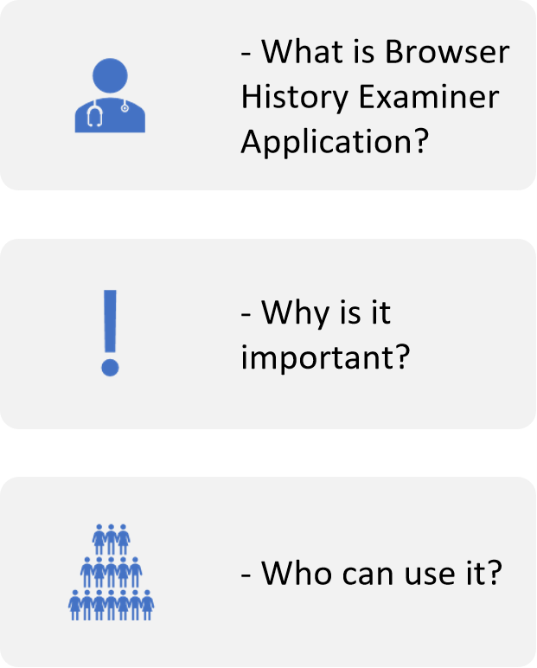
Introduction

Slide 3

Features
Browser history analysis
Keyword search
Multiple browser support
User-friendly interface

Slide 4

Compatibility
- Windows
- macOS
- Linux

Slide 5
Installation
Download the application
01
Run the installer
02
Follow the on-screen instructions
03

Slide 6

Support
Online documentation
Community forum
Email support

Slide 7
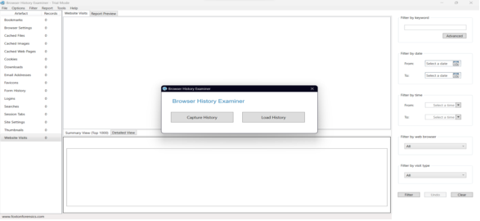
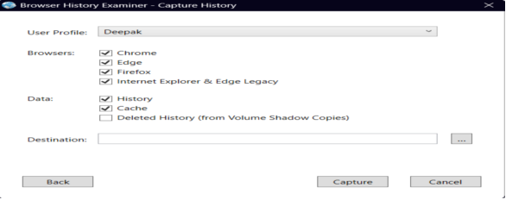
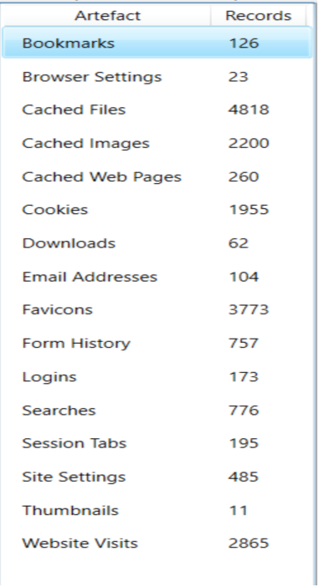
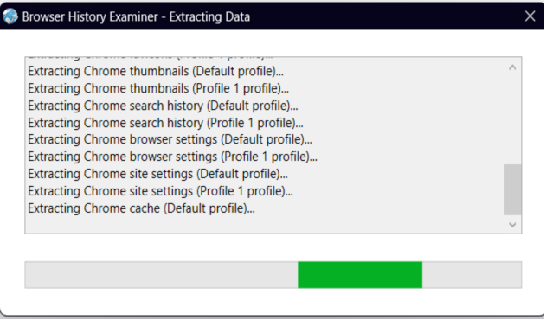
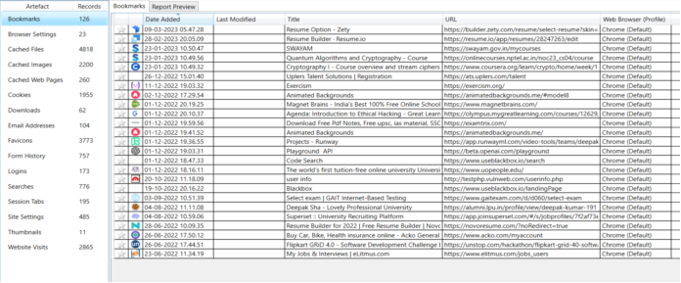
Some Snaps

Slide 8
Conclusion
Browser History Examiner Application is a powerful tool for analyzing browsing history.
It's easy to use and compatible with multiple operating systems.
With its user-friendly interface, it's accessible to all users.
Support is available through online documentation, a community forum, and email.
Download Browser History Examiner Application today and start analyzing your browsing history!

Slide 9
Thank You !

